Slide 1
Rationale Framework/Model/Theory
Christopher I. Macintosh, PhD, RN
Notes:
Hello everyone
My name is Chris Macintosh. I help teach the capstone courses.
Today we’re talking about selecting a framework or model to guide the project.
[Next slide]

Slide 2
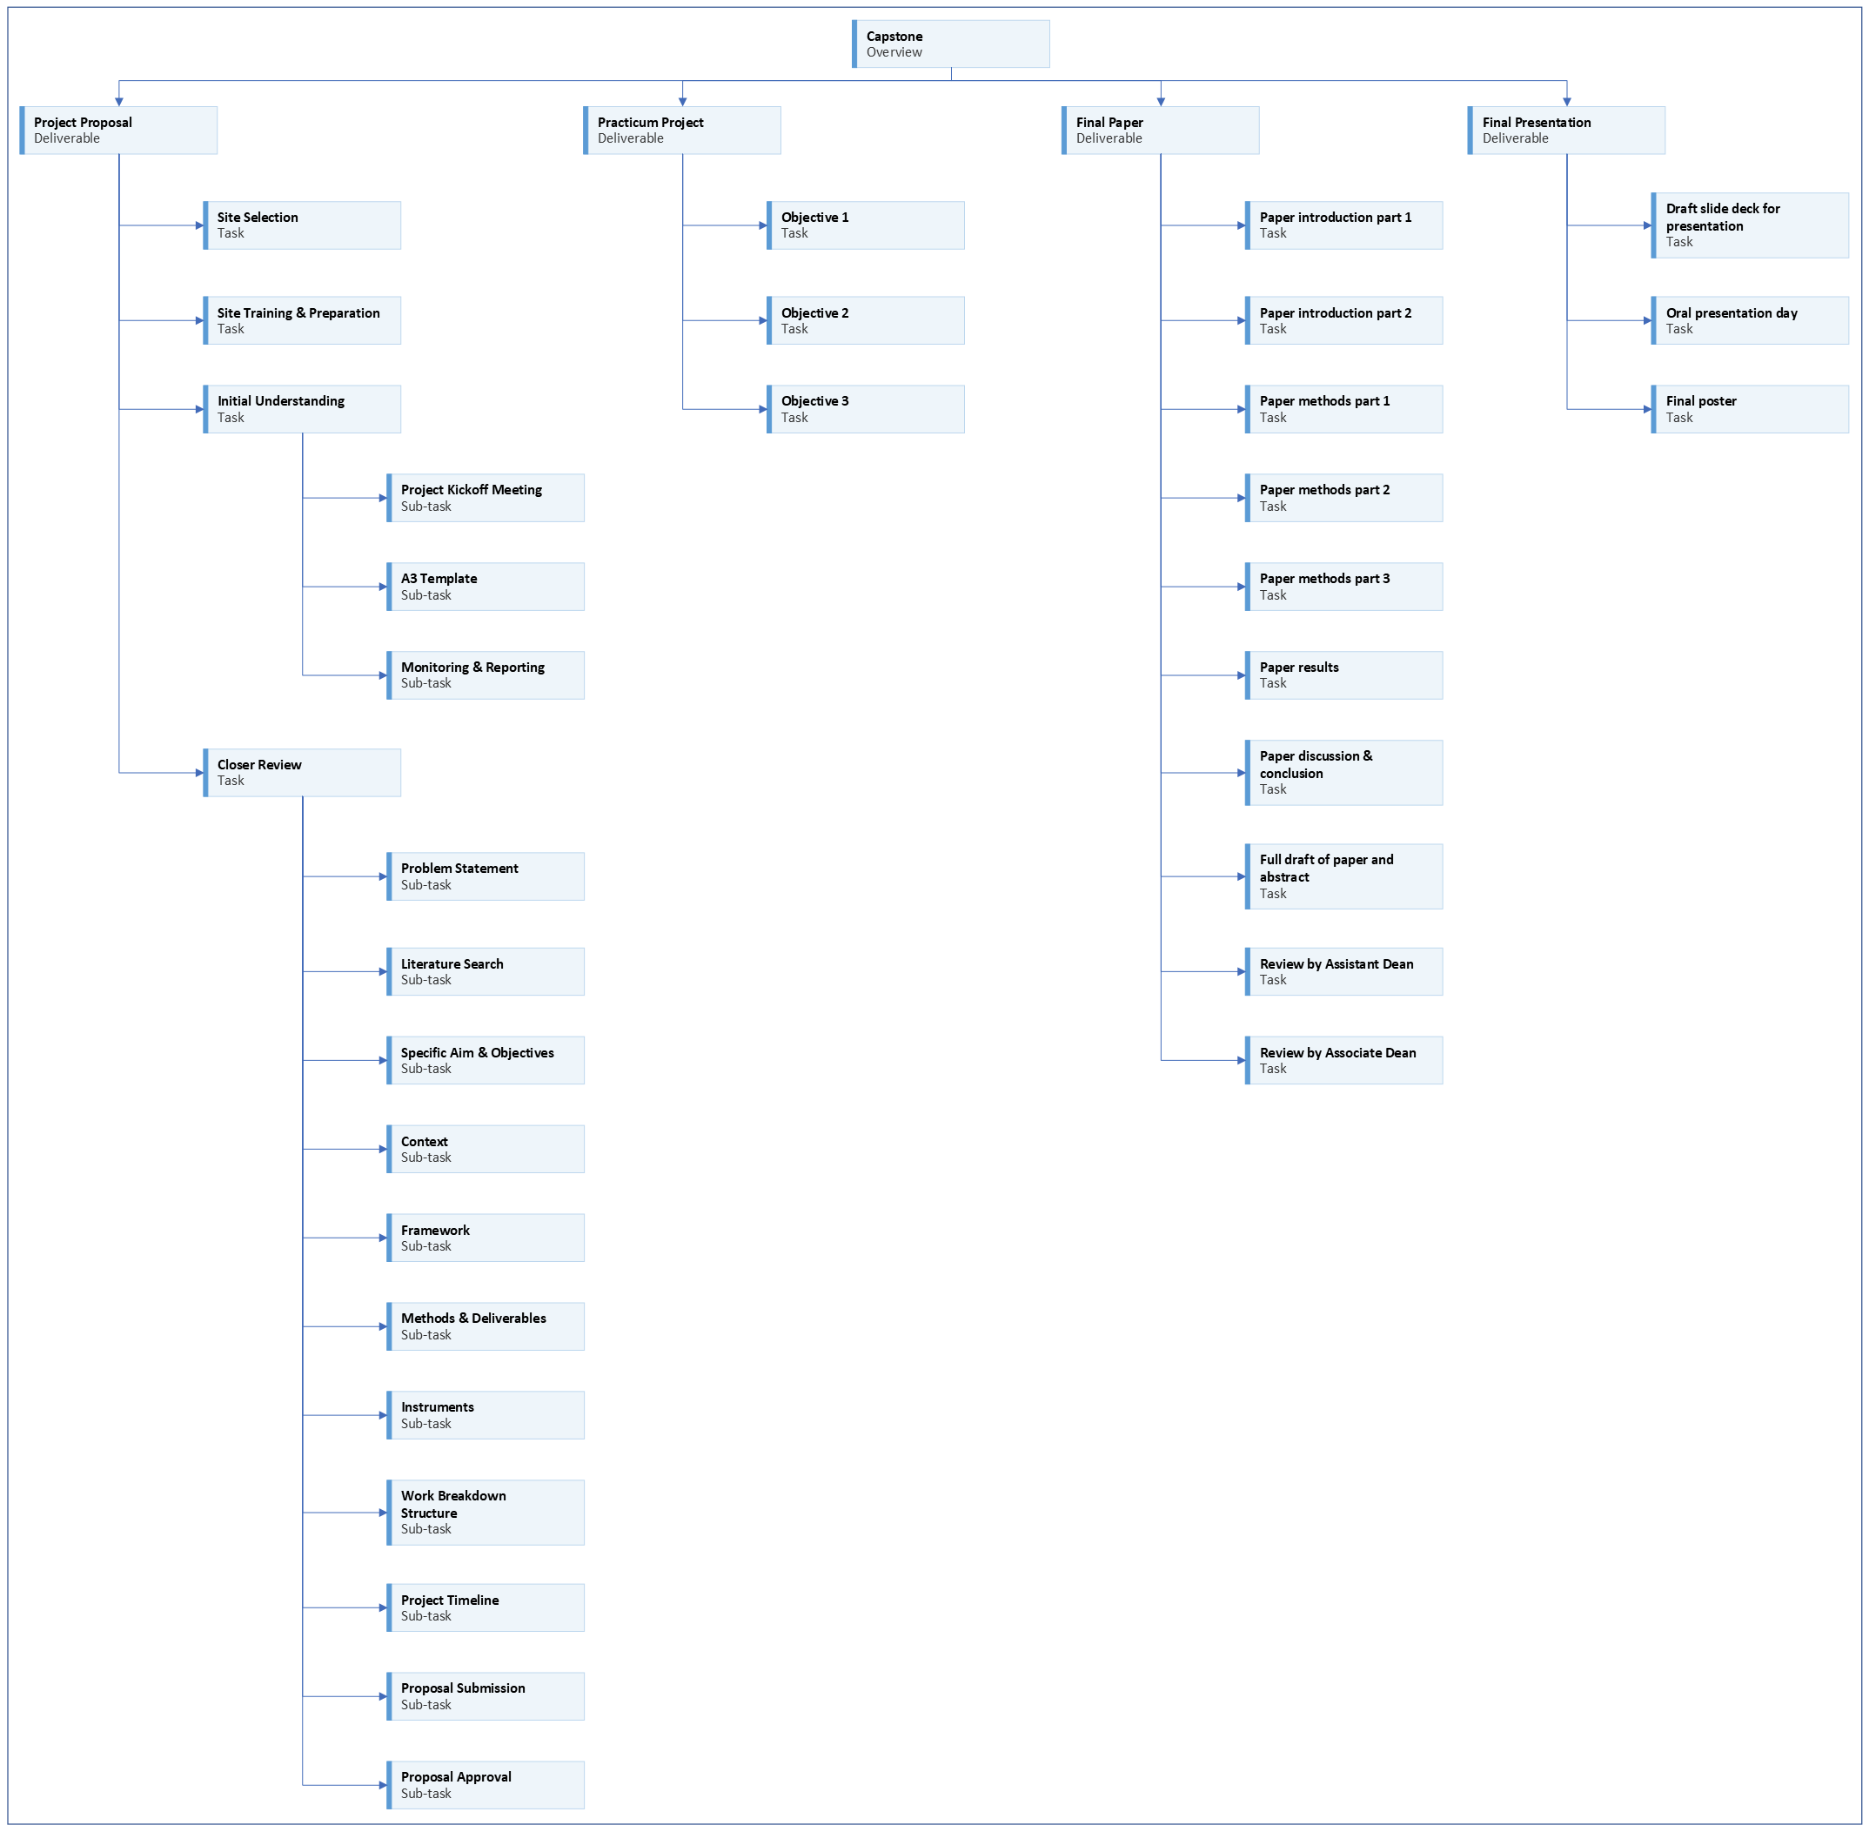
Notes:
[click]
We are working on the project proposal portion of your capstone experience.
[Next slide]

Slide 3
Notes:
Last time we talked about describing the context of your project.
[Next slide]

Slide 4
Notes:
Today we will talk about selecting a framework, model, or theory to guide your project.
[Next slide]

Slide 5

Address feedback
Notes:
You should be addressing any feedback on your assignments and pasting updated content in the appropriate sections.
[next slide]

Slide 6


Methods
THEORY
VS
LITTLE TO NONE
Notes:
We need something to guide the methods of our project.
[click]
Our methods should be based upon a sound understanding of our objectives and settings.
[click]
Not just something we threw together quickly.
[next slide]

Slide 7
Theory definition
“A theory is a set of interrelated concepts, definitions, and propositions that explains or predicts events or situations by specifying relations among variables.”
(Glanz, n.d.)
Notes:
Read
[next slide]

Slide 8
Theory importance
“Theories and models help explain behavior, as well as suggest how to develop more effective ways to influence and change behavior.”
(Glanz, n.d.)
Notes:
Read
[next slide]

Slide 9
Choosing a theory
“The choice of a suitable theory or theories should begin with identifying the problem, goal, and units of practice, not with selecting a theoretical framework because it is intriguing, familiar, or in vogue. One should start with a logic model of the problem and work backwards to identify potential solutions.”
(Glanz, n.d.)
Notes:
Read
[next slide]

Slide 10

Notes:
We could spend a long time talking about theories.
It’s not quite as bad a counting stars.
But sometimes it seems like it could be close.
[next slide]

Slide 11

Theory vs framework
(Imenda, 2014)
Notes:
As if theories weren’t complicated enough, there are also conceptual frameworks.
Suffice it to say both theories and frameworks define relationships and help explain phenomena.
From here on out, I’ll use the terms interchangeably for our purposes.
[next slide]

Slide 12
Why does a project need a theory?
A theory will help you design and implement your study to have the greatest possible impact which is often small and local (and more likely to succeed)
A theory give you a reasonable expectation, based on what is already known, that a new intervention will work
A resource that is routinely drawn on as you seek to explain what you see, experience, and learn
Theory may help suggest ways to evaluate success
Notes:
Why does a project need a theory?
[click]
Read
[click]
Read
[click]
Read
[next slide]

Slide 13
How to find a theory?
Is there a framework in use?
Use Plan-Do-Study-Act (PDSA)
Other theories/frameworks as appropriate
Notes:
How do you select a theory or framework for your project?
[click]
Is your site already using a theory or framework to guide their projects?
If there is, you should learn what it is and more about it.
Ask your preceptor if there’s any literature to read.
[click]
The Plan-Do-Study-Act (or PDSA) framework was designed to guide quality improvement.
[click]
Some projects may need guidance on designing appropriate interventions.
Investigating relevant theory may be helpful.
Search scholarly literature for your concept(s) of interest and the terms “theory” or “framework” or “model”
Your practicum preceptor and faculty advisor can also help advise you on that.
[next slide]

Slide 14




assignment
Notes:
[click]
Your assignment is to write about the framework/model/theory used to guide the activities of your project.
(You may have more than one.)
[click]
Describe how it aligns with and guides the work on your project.
[click]
It may be helpful to add a diagram of the framework if one exists.
Include any figures after the reference section.
Cite relevant literature.
[click]
You may also discuss any reasons or assumptions that were used to develop the intervention(s),
and reasons why the intervention(s) was expected to work.
Cite any evidence you may find that supports why this type of intervention may work.
[next slide]

Slide 15




Writing tip
Notes:
I will reiterate the writing tips.
The Framework/Theory assignment will eventually become the Rationale section of your project proposal and manuscript.
[click]
The more writing you can do this semester; the easier next semester will be.
[click]
Eventually I will be looking for well-formed paragraphs with topic sentences and supporting statements.
[click]
One way to check for well-formed paragraphs is try reverse outlining.
After you write your paragraph, highlight your topic sentence.
(I usually like to use light-gray to highlight topic sentences.)
Then check to see if the supporting statements in the paragraph support the topic sentence.
If they don’t all seem to support the topic sentence, then you need to write a broader topic sentence or split the paragraph into different paragraphs with separate topics.
[next slide]

Slide 16

More to come . . .
Notes:
That’s all we’ll do in this video.
There is more to come.
[next slide]

Slide 17
References
Glanz, K. (n.d.). Social and behavioral theories. National Institutes of Health. Retrieved April 10 from https://obssr.od.nih.gov/sites/obssr/files/Social- and-Behavioral-Theories.pdf
Imenda, S. N. (2014). Is There a Conceptual Difference between Theoretical and Conceptual Frameworks? Journal of Social Sciences, 38, 185 - 195.

